Slide 1
nWave: Application of ML to optimize project delivery
Team 4 - Ganesh Botcha, Sandipan Chakraborty, Jayanta Dutta, Sebastian Arenas

Slide 2
Agenda
Our Task in hand
What we want to accomplish using ML?
How we will accomplish it?
Process Diagram
How it works?
Next Steps
Q&A
Appendix (for reference)

Slide 3
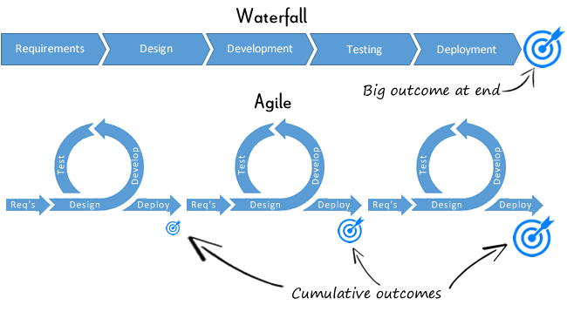
Our Task in hand
Develop a conceptual document detailing the role of “Machine Learning” in optimizing the Design and Build phases of IPM projects delivery.
This concept if selected will be leveraged to build the solution later by a development team

Slide 4
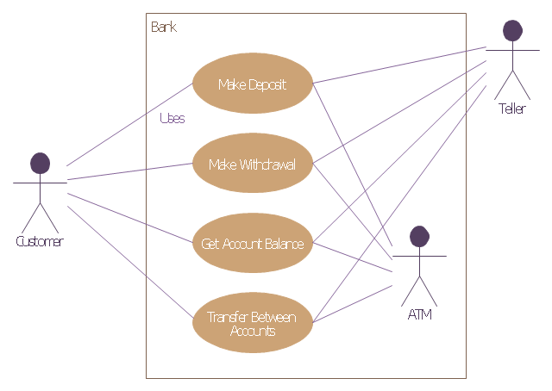
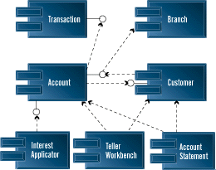
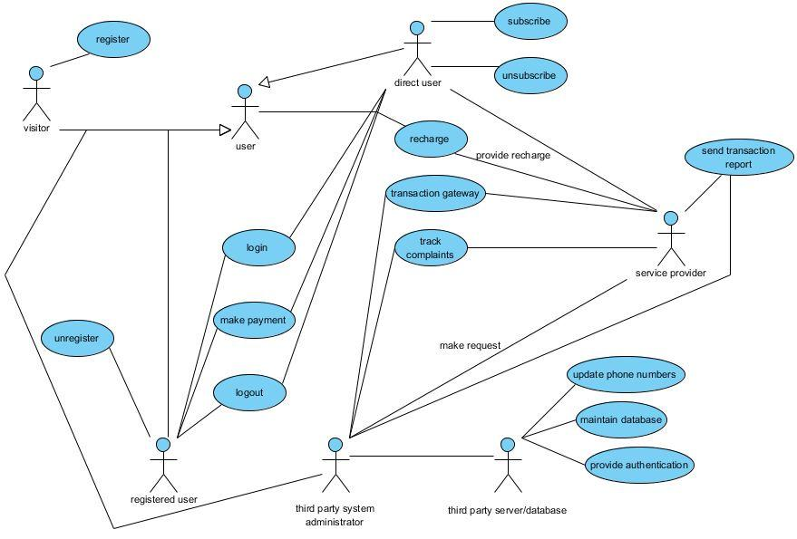
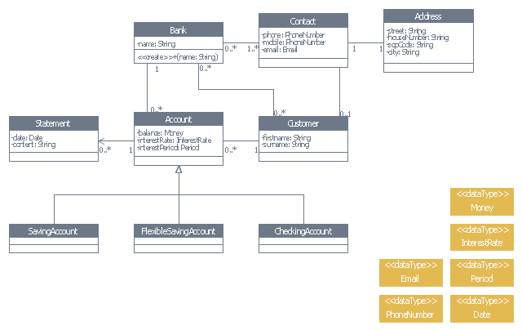
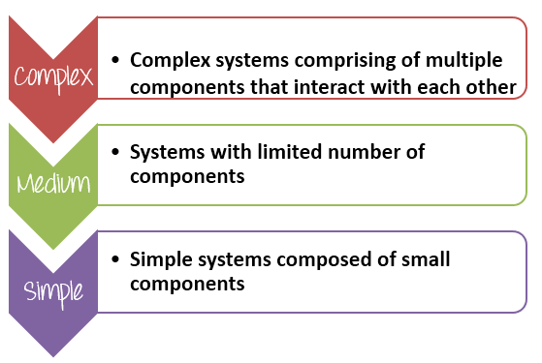
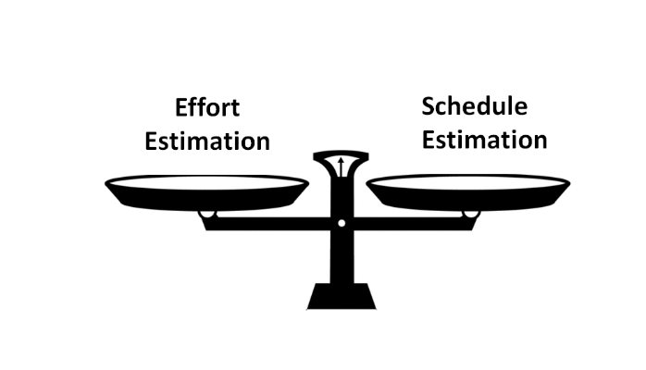
What we want to accomplish in “Design” phase using ML?
(1) Review BRD
(2) Identify Use Cases
(3) Identify the dependency between Use Cases
(4) Identify System Components
(5) Identify Data Base Elements and Relationships
(6) Identify the complexity of each component
(7) Estimate Development Efforts
NOTE: This solution if developed may save 75% of Design phase efforts

Slide 5
How we will accomplish it?
Using “Natural Language Processing (NLP)”
NLP Technique | What it does?
Tokenization | Break the BRD into readable small units.
Discourse Analysis | Interpreting the meaning of a sentence on the basis of its preceding sentences.
Conference Resolution | Determines the relationship between sentences. It is used to understand whether two or more sentences are related to each other or not through part of speech bonding.
Automatic Summarization through RNN (Recursive Neural Network) | Produces a readable summary of a large chunk of text. Often used to provide summaries of text of a known type.
Topic Segmentation and Recognition | Given a chunk of text, separate it into segments each of which is devoted to a topic, and identify the topic of the segment.
Parts of Speech tagging etc. | Given a sentence, determine the part of speech for each word.

Slide 6
Process Diagram
Input BRD
[Standard Agile User Story format]
BRD Container
[Conversion into RAW Text and parse to Paragraphs]
Paragraph Tokenization
[Tokenization and unnecessary word removal based on Parts of Speech]
Word 2 Vec
[Conversion of Word to Vectors called Embedding]
[GloVe to obtain vector form of words through unsupervised learning]
Auto-Summarization
[Sequence to Sequence model: Use RNN for Attention Mechanism to prioritize data from Embedding]
Distance measurement of Use Case pair
Dependency Calculation for each Use Case pair
Form all possible pair combination of Use Cases
[(Ui,Uj) Pair where Ui and Uj will considered as Vertices in planar graph]
Conference Resolution
Parts of Speech Analysis
Use Case Classification
Summarized Paragraphs
Correlation calculation of Use Case pair
Average calculation and Correlation plotting on Linear graph
Manual analysis of Liner graph for identifying the scatter of Vertices in planar graph
Convert “Highly Dense” zones into Modular Functional Document
Identify “Highly Dense” zones from plot near the Vertices with larger number of Outgoing edges
Identify Vertices (Use Cases) with comparatively larger number of Use Cases
Identify Action, Acting Upon, Purpose, Actor for each Use Case

Slide 7

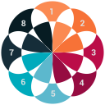




How it works?
Break It!
Tokenize the BRD into smaller paragraphs and thereby Use Cases through RNN Method, Parts of Speech Recognition and Conference Resolution. Sentences are analyzed to check if it can be included in current Use Case or the next One.
Now, time for Plotting
Put a threshold to eliminate edges which are longer than Average. Once the length of Edges are identified then start plotting the Use Cases as individual vertices over a planar graph.
Search and Understand
Identify the Action, Actor, Purpose and Acting Upon through Subject-Predicate and Parts of Speech recognition.
Actor- who is performing the action
Acting upon- upon which the action is being done
Action- mostly the Verb of sentence
Purpose- mostly the predicate of sentence
Analyze the Highly Dense Zones
Identify the Modularity through highly dense zones containing larger accumulation of Vertices. It designates highly coupled use cases with shorter edges. Find out the Use Cases with higher number of Edges connected. Rank the use cases based on edge counts and categorize into Complex, Medium and Simple. Complex ones have larger outgoing edges.
Measure Dependency
Calculate the Inter-relationship value between Use Cases. The values will help in yielding two parameters.
Length of Edge (for plotting in Graphical Analysis)
Correlation or Dependency factor (inverse to Length of Edge)
Yay, we got it!
Highly dense zones are converted to Functional Modularity document.
Use Cases are categorized into Complex, Medium, Simple
Use cases pertaining to Core B-logic can be identified by parts of speech (if-then-else)
Integration/Process/Entity etc based Use Cases can be segregated.
LOE can be derived from number and complexity of Use Cases

Slide 8
Next Steps
Develop the remaining algorithms if any left in “Design” Phase
Start with “Build” Phase to apply Machine Learning
Work with Development Team to build the solution if our concept is selected

Slide 9


Slide 10
Appendix-Case Study (User Stories/Sentences)
User Story ID | As a <type of user> | I want to <perform some task> | so that I can <achieve some goal>
1 | Customer | deposit check | I want to increase my bank balance
2 | Customer | withdraw cash from an ATM | I don't have to wait in line at the Bank
3 | Customer | want to transfer money from one account to another | I don't need to pay the amount in person
4 | Customer | pay my utility bills online | I don't need to write checks or use postal service
5 | Customer | apply for a loan | purchase a car
6 | Customer | request for check books | I can write the required number of checks
7 | Banker | restock sufficient cash in ATM machines | the customers can withdraw cash
8 | Banker | limit the cash withdrawl from ATM machines | more customers can prevail the ATM cash and also prevent fradulent activities
9 | Banker | I want to review all transactions of the day | I can debit and credit the right accounts
10 | Banker | review the credit history and the bank balance of customers that apply for loans | I can approve or reject the loan applications

Slide 11
Appendix-Case Study (Break into Use Cases)
Human
Machine
Statement ID | Processing Sentence/Statement |  |  | Use Case
User Story ID | As a <type of user> | I want to <perform some task> | so that I can <achieve some goal> | ID | Actor | Acting Upon | Action | Purpose | Sentence
1 | Customer | deposit check | I want to increase my bank balance | 1 | Customer | Bank | Deposit Check | Icrease bank balance~Add | 1
2 | Customer | withdraw cash from an ATM | I don't have to wait in line at the Bank |  | Customer | Bank | Withdraw | Don’t have to wait in line~Withdraw Balance | 2
3 | Customer | want to transfer money from one account to another | I don't need to pay the amount in person |  | Customer | Account~Bank | Transfer Money | don't need to pay the amount in person~Transfer | 3
4 | Customer | pay my utility bills online | I don't need to write checks or use postal service | 2 | Customer | Utility Bills | Pay Online | don't need to write checks or use postal service~Pay | 4
5 | Customer | apply for a loan | purchase a car | 3 | Customer | Loan~Bank | Apply | Puchase Car~Loan | 5
6 | Customer | request for check books | I can write the required number of checks | 4 | Customer | Cheque Book~Bankk | Request | can write the required number of Cheque~Request | 6
7 | Banker | restock sufficient cash in ATM machines | the customers can withdraw cash | 5 | Banker | ATM Machine | Request | ~Withdraw | 7
8 | Banker | limit the cash withdrawl from ATM machines | more customers can prevail the ATM cash and also prevent fradulent activities |  | Banker | ATM Machine | Limit | Case withdrawal, customers can prevail the ATM cash and also prevent fradulent activities~Withdraw | 8
9 | Banker | I want to review all transactions of the day | I can debit and credit the right accounts | 6 | Banker | Transaction | Review | debit and credit the right accounts~Review | 9
10 | Banker | review the credit history and the bank balance of customers that apply for loans | I can approve or reject the loan applications |  | Banker | Credit History | Review | approve or reject the loan applications~Review | 10

Slide 12
Appendix-Case Study (Finding Correlation)
Coupling |  | Actor |  |  | Acting Upon |  |  | Action |  |  | Purpose |  |  | Distance | Correlation | Co- Efficient
Use Case | Use Case | Union | Intersect | Dependency | Union | Intersect | Dependency | Union | Intersect | Dependency | Union | Intersect | Dependency |  |  | X1 | X2 | X3 | X4 | X5
1 | 2 | Customer(4) | Customer(4) | 1 | Bank Utility Bills |  | 0 | Deposit Cheque Pay Online |  | 0 | Debit(3) Credit | Debit(3) | 0.75 | 1 | 1.727272727 | 1 | 1 | 0.2 | 0.5 | 1
1 | 3 | Customer(4) | Customer(4) | 1 | Bank | Bank | 1 | Deposit Cheque Apply |  | 0 | Debit(2) Credit Loan |  | 0 | 2 | 2.5 | 1 | 1 | 0.2 | 0.5 | 1
1 | 4 | Customer(4) | Customer(4) | 1 | Bank | Bank | 1 | Deposit Cheque Request |  | 0 | Debit(2) Credit Request |  | 0 | 3 | 3.5 | 1 | 1 | 0.2 | 0.5 | 1
1 | 5 | Customer(3) Banker(2) |  | 0 | Bank ATM Machine |  | 0 | Deposit Cheque Request |  | 0 | Debit(4) Credit | Debit(4) | 0.8 | 4 | 6.5 | 1 | 1 | 0.2 | 0.5 | 1
1 | 6 | Customer(3) Banker(2) |  | 0 | Bank Transaction |  | 0 | Deposit Cheque Review |  | 0 | Debit(2) Credit Review |  | 0 | 5 | NA | 1 | 1 | 0.2 | 0.5 | 1
2 | 3 | Customer Banker |  | 0 | Utility Bills Bank |  | 0 | Pay Online Apply |  | 0 | Debit Loan |  | 0 | 1 | NA | 1 | 1 | 0.2 | 0.5 | 1
2 | 4 | Customer Banker |  | 0 | Utility Bills Bank |  | 0 | Pay Online Request |  | 0 | Debit Request |  | 0 | 2 | NA | 1 | 1 | 0.2 | 0.5 | 1
2 | 5 | Customer Banker(2) |  | 0 | Utility Bills ATM Machine |  | 0 | Pay Online Request Limit |  | 0 | Debit(3) | Debit(3) | 1 | 3 | 5 | 1 | 1 | 0.2 | 0.5 | 1
2 | 6 | Customer Banker(2) |  | 0 | Utility Bills Transaction |  | 0 | Pay Online Review |  | 0 | Debit Review |  | 0 | 4 | NA | 1 | 1 | 0.2 | 0.5 | 1
3 | 4 | Customer(2) | Customer(2) | 1 | Bank | Bank | 1 | Apply Request |  | 0 | Loan Request |  | 0 | 1 | 1.5 | 1 | 1 | 0.2 | 0.5 | 1
3 | 5 | Customer Banker(2) |  | 0 | Bank ATM Machine |  | 0 | Apply Request Limit |  | 0 | Loan Debit(2) |  | 0 | 2 | NA | 1 | 1 | 0.2 | 0.5 | 1
3 | 6 | Customer Banker(2) |  | 0 | Bank Transaction |  | 0 | Apply Review |  | 0 | Loan Review(2) |  | 0 | 3 | NA | 1 | 1 | 0.2 | 0.5 | 1
4 | 5 | Customer Banker(2) |  | 0 | Bank ATM Machine |  | 0 | Request Limit | Request | 1 | Request Debit(2) |  | 0 | 1 | 6 | 1 | 1 | 0.2 | 0.5 | 1
4 | 6 | Customer Banker(2) |  | 0 | Bank Transaction |  | 0 | Request Review |  | 0 | Request Review |  | 0 | 2 | NA | 1 | 1 | 0.2 | 0.5 | 1
5 | 6 | Banker(4) | Banker(4) | 1 | ATM Machine Transaction |  | 0 | Request Limit Review |  | 0 | Debit(2) Review(2) |  | 0 | 1 | 2 | 1 | 1 | 0.2 | 0.5 | 1
* Dry run approach through mathematical models
** The analysis quantifies the feasibility of this approach
*** The model is not coded yet. It is a transformation of human intelligence into mathematical formula which will help in MLP

Slide 13
Appendix-Case Study (Plotting to Graph)
Use Case1 | Use Case2 | Correlation | Significant Edges
A | B | 1.72727273 | AB
A | C | 2.5 | AC
A | D | 3.5 | AD
A | E | 6.5 | Excluded above average
B | E | 5 | Excluded above average
C | D | 1.5 | CD
D | E | 6 | Excluded above average
E | F | 2 | EF
 | Average | 3.59090909
Use Case Vertex | Number of Edges
A | 3 | Highly dense area. Complex Use Case
B | 1
C | 2
D | 2
E | 1
* Dry run approach through mathematical models
** The analysis quantifies the feasibility of this approach
*** The model is not coded yet. It is a transformation of human intelligence into mathematical formula which will help in MLP

